Slide 1

Apache Airflow
The Good, The Bad, and the Ugly

Slide 2



Apache Airflow
Simple Concepts: The 3 components
webserver
scheduler
executor

Slide 3
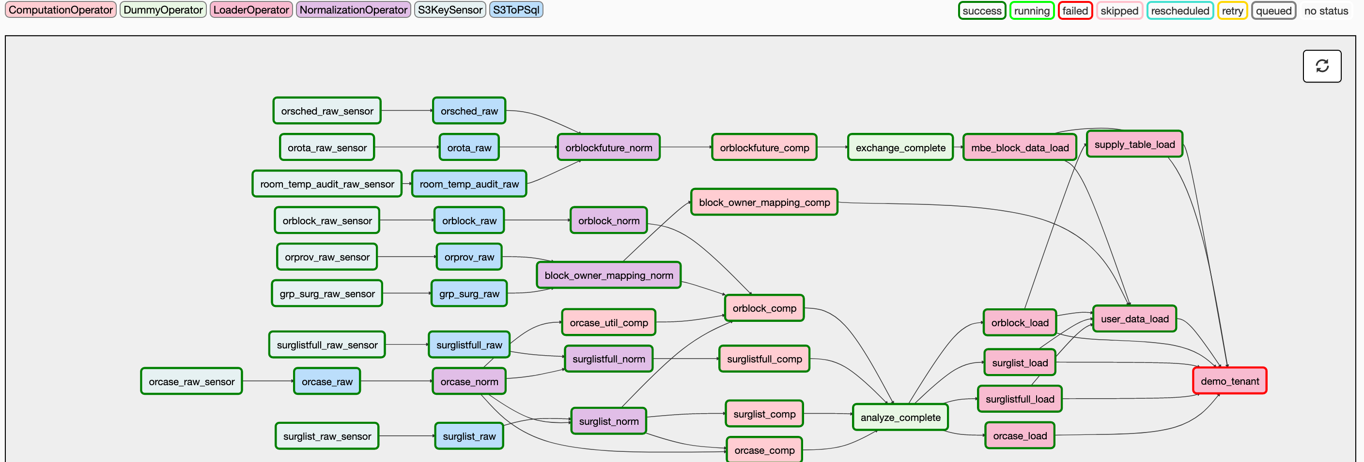
Apache Airflow
Simple Concepts: Directed Acyclic Graphs
Notes:
Chron guessing game
When can I schedule my job?
What happens if one file doesn’t come in?
What happens if one large file without much dependencies is lagging behind at 6? Did I optimistically complete as much as I could have?

Slide 4
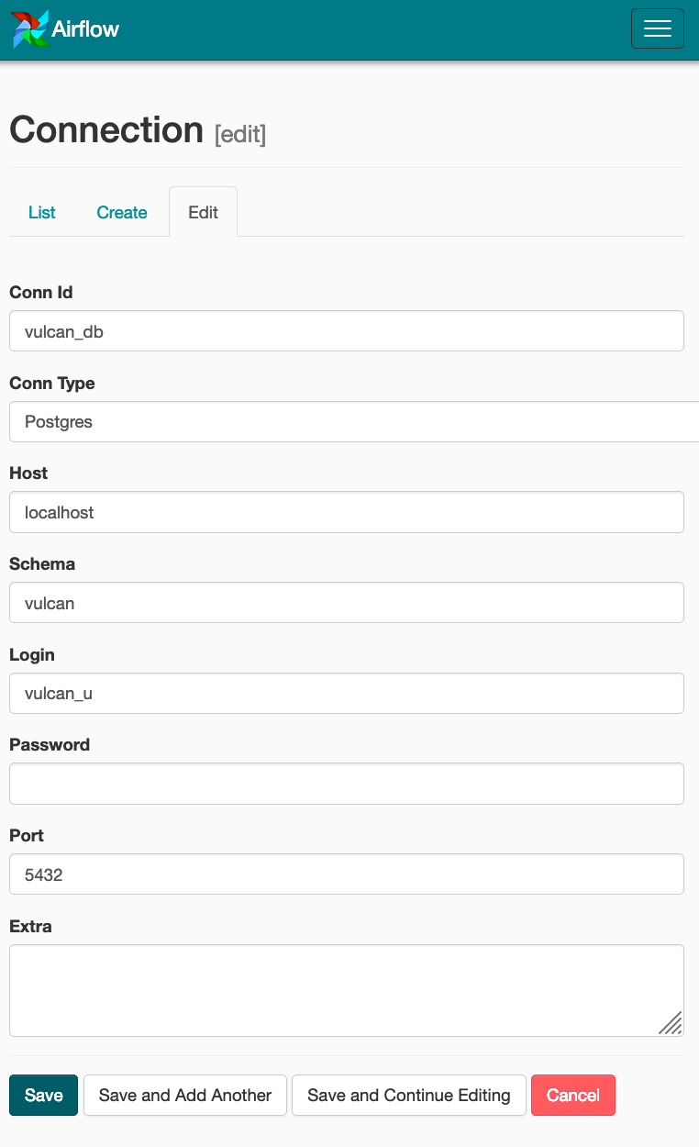
Apache Airflow
Simple Concepts: Hooks + Connections
A hook is any service that exists outside airflow
Slack/Twilio
Postgres/MySQL/Hive/Redis
Docker
Chef
Kafka/SQS/RabbitMQ
Allows for code to be uniform across multiple environments

Slide 5
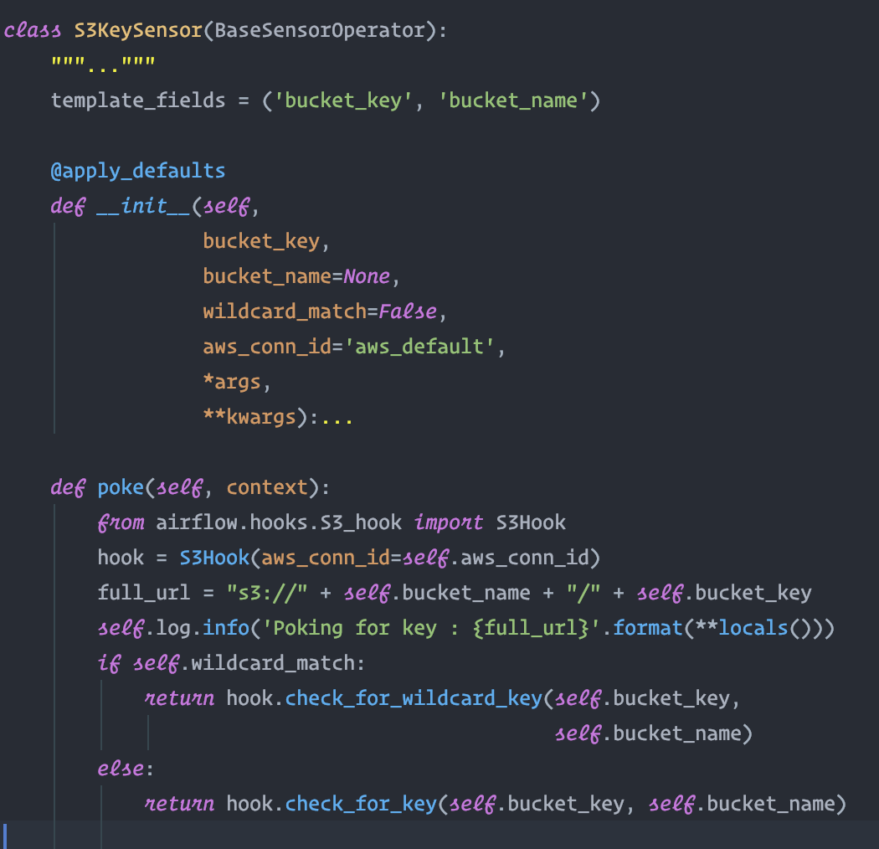
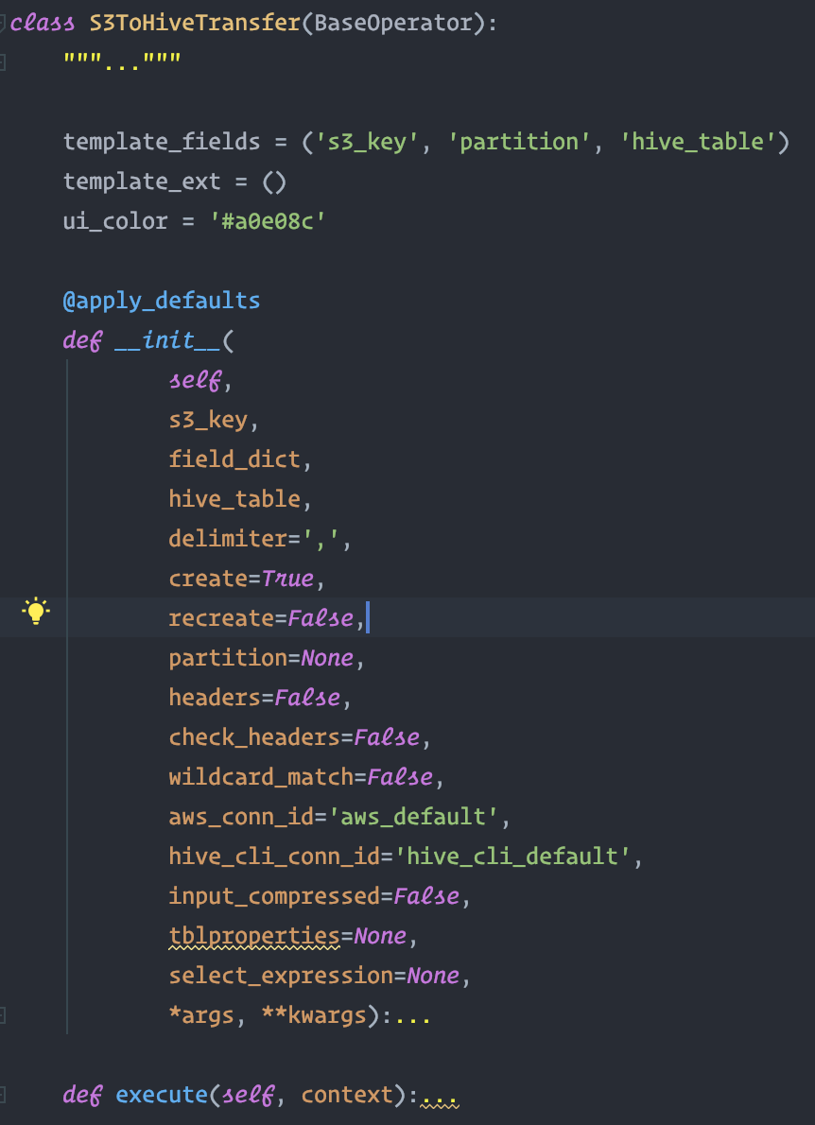
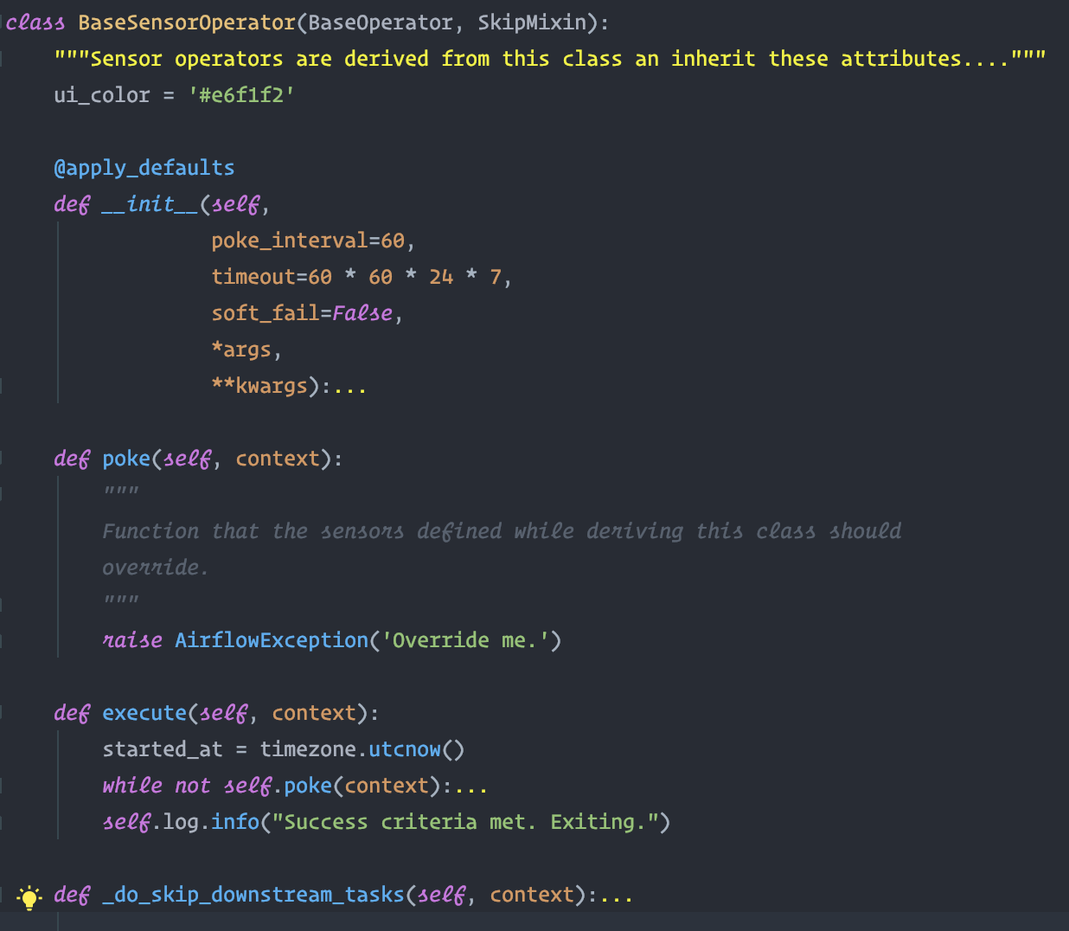
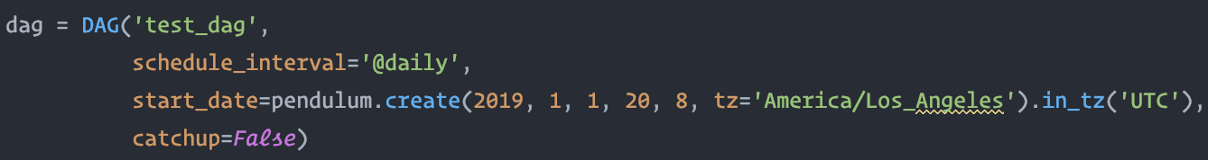
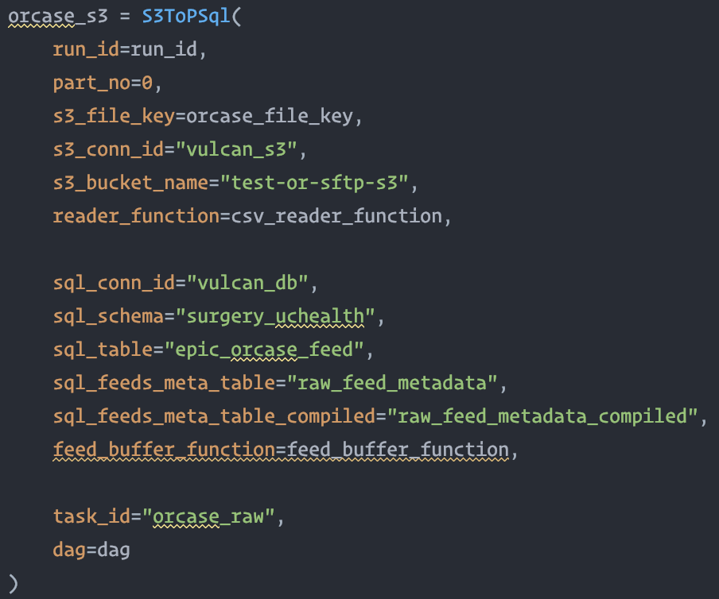
Apache Airflow
Simple Concepts: Operators + Sensors + Tasks
An Operator is a class that is given a few parameters and executes() a single task (for example, S3 to Hive Operator)
A sensor is a type of operator that continuously pokes() until a condition is met
A task is what happens when you instantiate an Operator, and assign it to a DAG

Slide 6
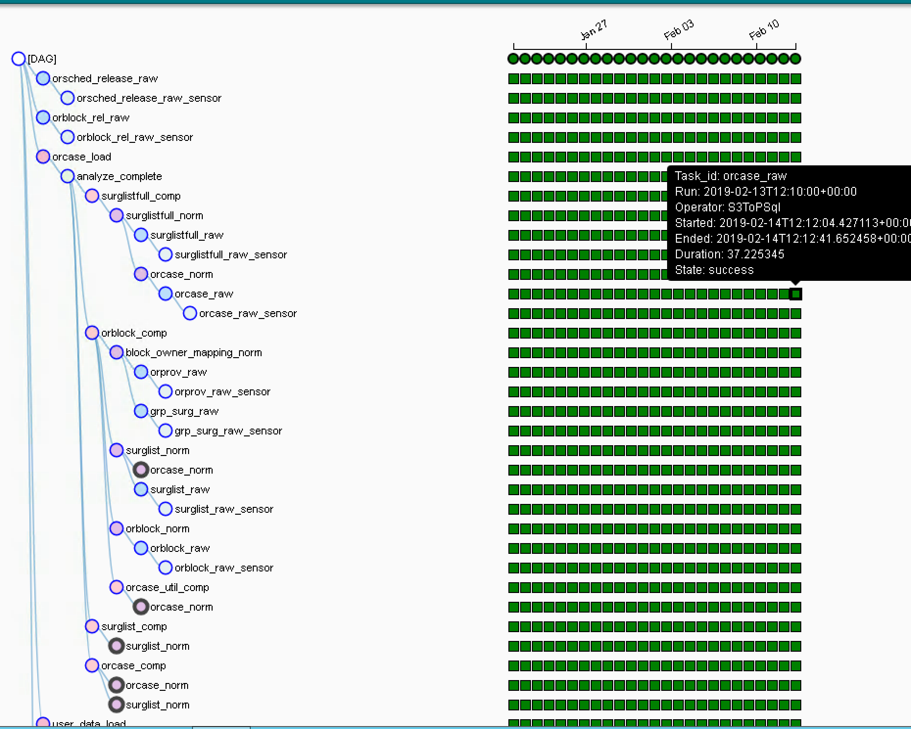
Apache Airflow
Simple Concepts: Dag Runs + Task Instances
DAG Runs
Task Instances

Slide 7
Apache Airflow
This is just the beginning…

Slide 8
Apache Airflow
In-Depth Look: Web Server
Airflow is not a SPA. HTML generated server-side.
Everything is Flask. You can extend Airflow with plugins and flask blueprints.
The webserver also monitors when DAG files change
Can hot-reload DAG-Bags
Most buttons map to the CLI interface
Rest APIs are experimental.
UI Dependencies on
BootStrap 3 (and JQuery), Moment JS
HTML 5 SVGs
webserver

Slide 9
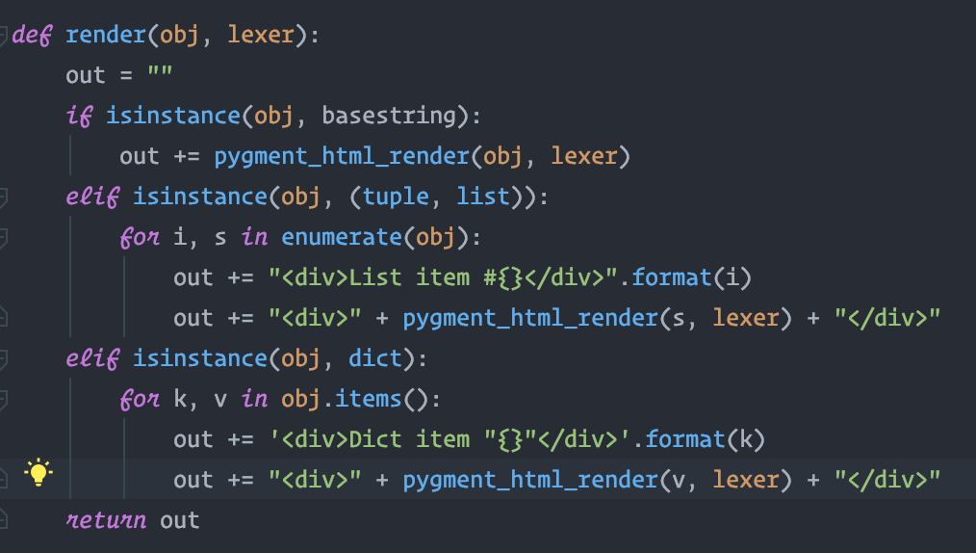
Apache Airflow
In-Depth Look: Web Server
Airflow’s main render function in views.py
webserver

Slide 10
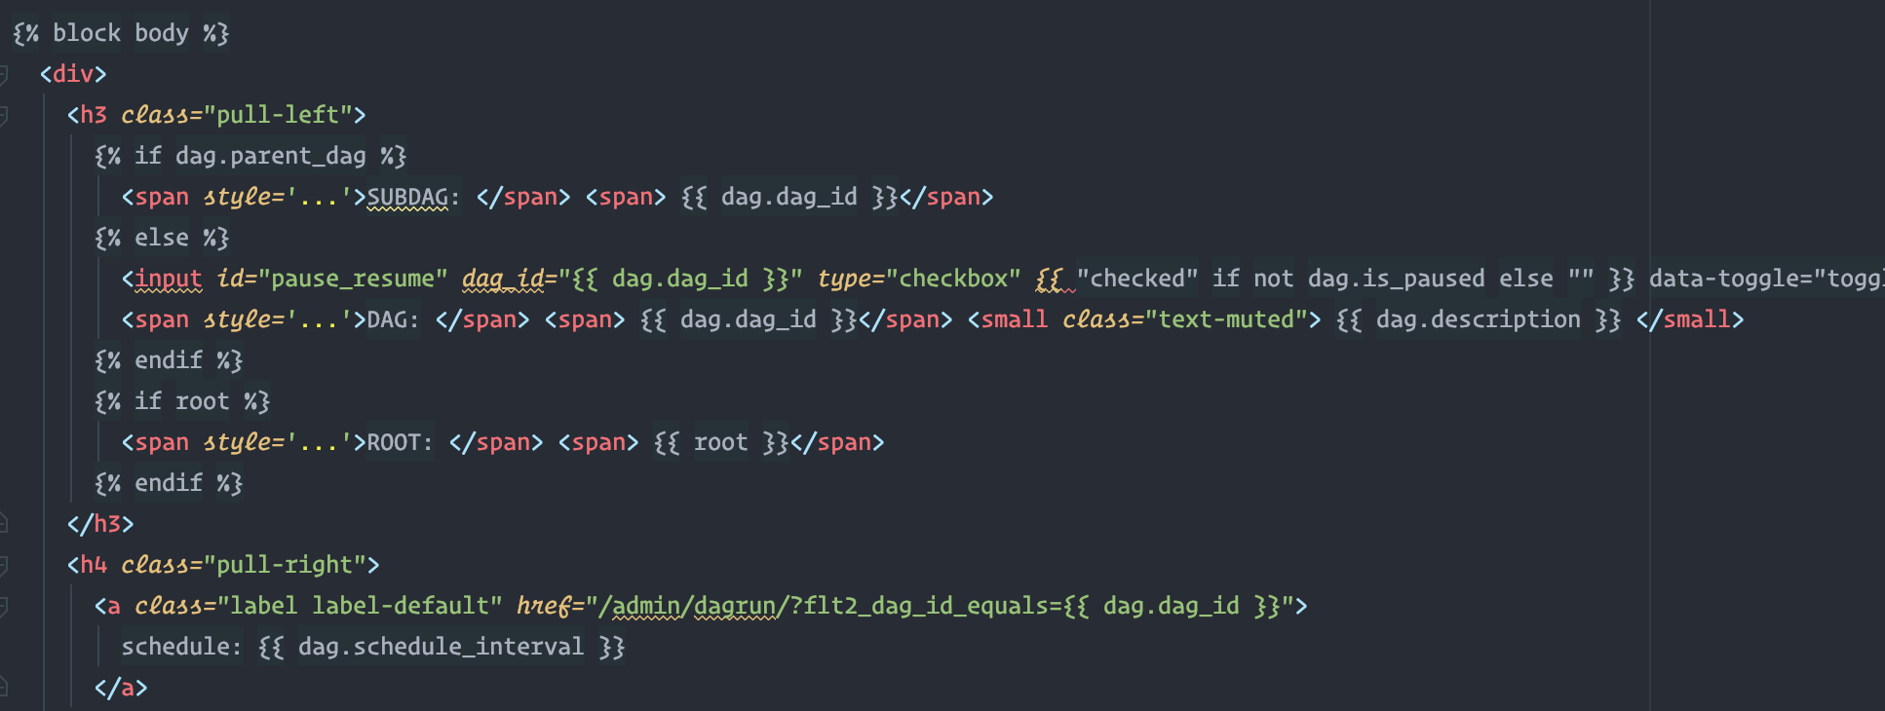
Apache Airflow
In-Depth Look: Web Server
Example: Airflow’s dag.html
webserver

Slide 11
Apache Airflow
In-Depth Look: Scheduler
The Scheduler is neurotically doing to following
Fill up DAGs into DagBags
Use Dag definitions to identify and/or init DAG Runs in MetaDB
Check task instances of current DAG Runs by querying the MetaDB.
If a task needs to be run, generate the CLI string and tell the executor to run that command
Scheduler will change status to ‘QUEUED’
It’s the worker’s job to not only do the task, but also update the Meta DB. Worker changes status to ‘RUNNING’, ‘FAILED’, or ‘SUCCESS’
Scheduler goes back & updates the state of DagRuns in the DB (with upstream-failures if applicable)
Base Airflow does not need a queueing system
scheduler

Slide 12
Apache Airflow
In-Depth Look: Scheduler
To the scheduler every task becomes a string representing a CLI statement
It gives this string to the Executor
airflow run [dag_id] [task_id] [datetime] [job_id] [dag_dir] [cfg_path]
/Users/ahmed/Documents/vulcan/env/bin/python /Users/ahmed/Documents/vulcan/env/bin/airflow run test_dag surglist_sensor 2019-02-13T00:00:00+00:00 --job_id 3682 --raw -sd DAGS_FOLDER/test_dag.py --cfg_path /var/folders/46/1t9kpg9j6vzfws8by8_m1m4m0000gn/T/tmp70c9r7eo
scheduler

Slide 13
Apache Airflow
In-Depth Look: Executor
Must have the same environment as scheduler in order to run the verbatim CLI command passed in
Overriding an Executor is possible through plugins, you just need to be able to:
start() ~ initialize all stateful variables & connections
__init__() ~ used only to grab additional configs
execute_async() ~ execute the given airflow command asynchronously.
Takes in a key: Tuple of dag_id, task_id, and execution_date
command: the string CLI command to be run in shell to start a process
Queue: optional object representing a queue
Executor config
sync() ~ gather statuses on currently running jobs. Runs with every heartbeat
end() ~ Scheduler wants the executor to wrap-up all jobs, and is waiting for total completion
terminate() ~ In case of sigterm, terminate all jobs everything & call end()
Executor

Slide 14
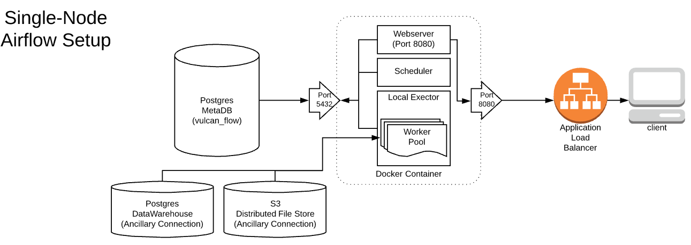
Apache Airflow
In Depth Look: Single-Node (Local Executor)
Executor
Notes:
* Big Jobs running
*

Slide 15
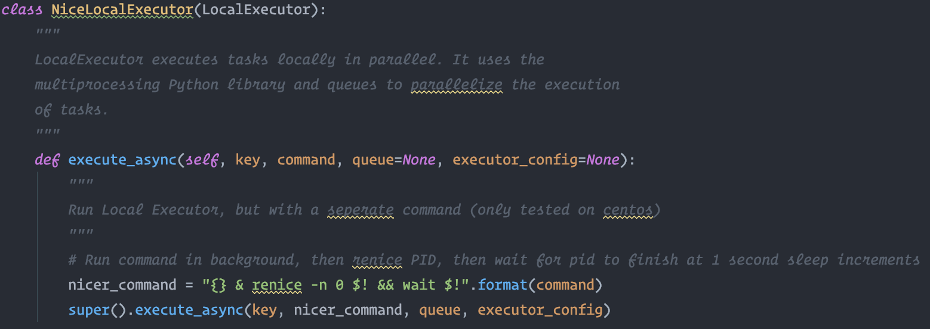
Apache Airflow
In Depth Look: Single-Node (Customized Nice-Local Executor)
Executor
Notes:
* Big Jobs running
*

Slide 16
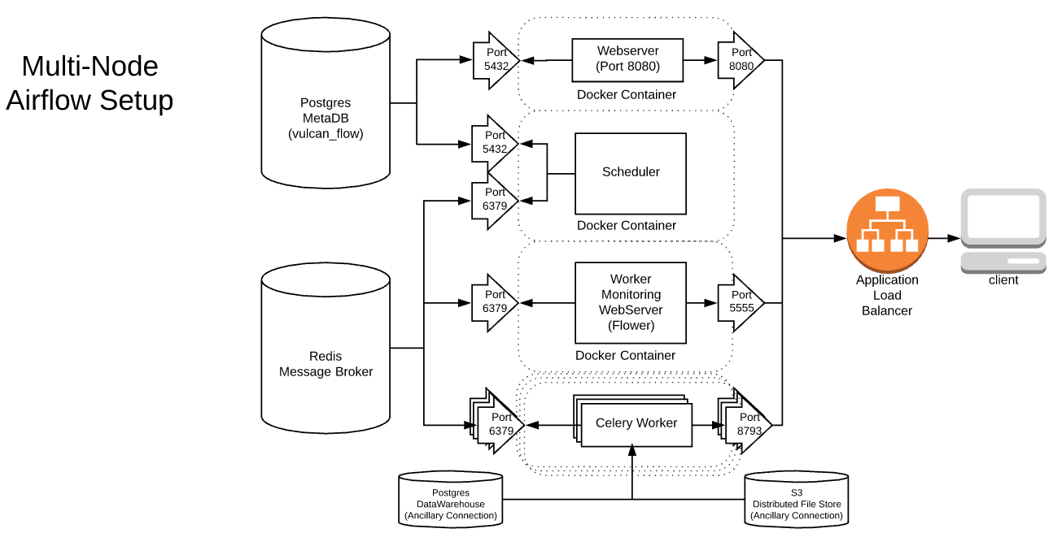
Apache Airflow
In Depth Look: Multi-Node (Celery Executor & beyond)
Executor

Slide 17
Apache Airflow
What’s Good about Airflow?

Slide 18

Apache Airflow
What’s Good about Airflow
It’s Opinionated (compared to Luigi)
Hooks, Dags, Operators, Task Instances, Connections, SLAs, Landing Times, Gnatt Charts, etc.
The UI democratizes job monitoring
Code > UI Frameworks
Out-sources Execution
Plugins are a good idea (in theory)
Quick way to store job history

Slide 19

Apache Airflow
What’s Airflow doesn’t even attempt to handle
This is not a place to run your large python jobs.
Library packaging can be terrible
Dag Versioning is a bit of a problem
Deployment across a distributed file system
Not a place for streaming

Slide 20
Apache Airflow
How not to shoot yourself in the foot

Slide 21
Apache Airflow
Ways to shoot yourself in the foot
Make tasks Idempotent. Don’t pass information along your dag run unless you have to (XCOMs)
Don’t express environment-specific code outside of connections and hooks
Operators should avoid additional dependencies
If you’re a large company: Find another place to run your heavy-lifting jobs, and let Airflow do what it’s good at
If you’re a small company: Boil down your requirements to its essentials. Get every job to share the same requirements
Dag Versioning & Backfills. Create two DAGs if you need to..
Avoid sub-DAGs. They’re not ready (as of this moment). Use factory-methods instead.
Don’t try to build a framework on top of Airflow. Airflow is already opinionated enough.
Airflow is most optimal in ECS/Fargate/Kubernetes/Mesos rather than Celery (at scale).

